Slide 1
Business Monitoring Software
Department of Information Technology
(2016-17)
By
Prerana Tirodkar – 7169
Isha Naik – 7153
Akshay Jhadav – 6820
Under the Guidance of
– Prof. Prachi Patil

Slide 2
CONTENTS
Introduction
Literature Review
3) Problem Statement
4) Project description
5) References

Slide 3
INTRODUCTION

Slide 4
Introduction
“ERP- Enterprise Resource planning is cross functional enterprise system driven by integrated suite of software modules that supports basic internal business processed of the company.”
Carries common business functions and integrates business activities across enterprise.
Optimises maintains and tracks business functions.
Serves as a planning , purchasing , HRM , CRM , finance, analysis solution to organisation.

Slide 5
Literature survey
i) Characteristics of system :
- Flexibility
Easy adaptation
Cost effective
Support and stability
Spots trends
Decision support
Risk detection and management

Slide 6
j) Functions/components of system
Literature Survey (contd.)
Analytics
Human resource management
Finance management
Purchase management
Performance monitoring
Customer relationship Management
Student (product) life cycle management
Marketing and sales (analysis and control)

Slide 7
k) Introduction Of Company
Literature Survey (contd.)
ERP system for CATKing
MBA coaching institute
Containing
2000 students across center
spread across 5 locations
estimated business growth 50%

Slide 8
PROBLEM STATEMENT

Slide 9
Problem statement
To create a
Student life cycle monitoring
Intern and employee performance tracker.
Reducing approvals time frame.
Automating the data updating system.
Reduction in excess fund allocation.
Tracking the organisational targets.

Slide 10
PROJECT DESCRIPTION

Slide 11
Project description
Project overview
The Project helps Automatize system.
Helps in precise data analysis.
Report generation .
Finance Modelling and Controlling
Student Life Cycle Monitoring
Performance Monitoring

Slide 12
Project description- Project Modules
Performance monitoring
Student life cycle
Target allocation
Performance review
performance management
preference management
fund tracking
alerts
Customer relationship management
Marketing and sales
budget allocation
Monitoring
Risk management
Customer retention
centralised repository

Slide 13
Project description- Project Modules
Human resource management
Finance management
Employee management
Payroll management
Time/ preference management
Financial accounting
Enterprise controlling
Analytics (BI)
Business Analysis
Data Analysis

Slide 14
Software users
Project description (contd.)
Login
Top management
HR
Staff
Branch manager
sumit@gmail.com
Pass:- admin123
ishanaik27@gmail.com
staff123
ishita@gmail.com
branch123
Shreya@gmail.com
pass hr123

Slide 15
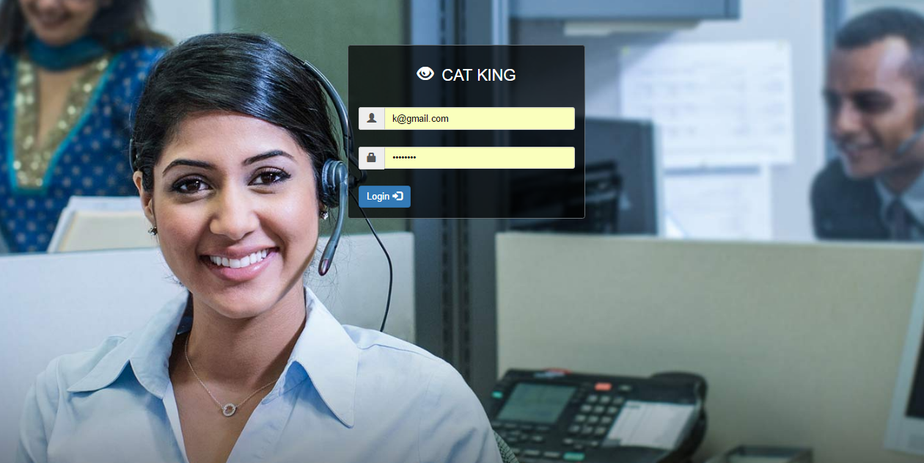
Login
Project description (contd.)

Slide 16
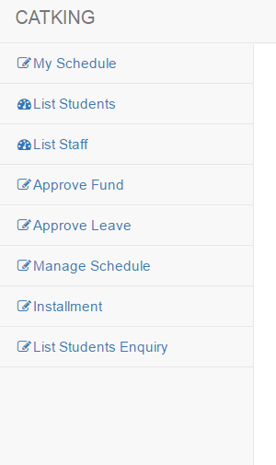
Top Management
Project description (contd.)
Access to all functions
top functions are :-
Fund allocation
Leave approvals
Check instalment summary
Access and make required changes to centralised data

Slide 17
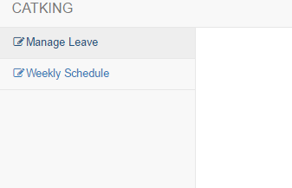
Staff
Project description (contd.)
Can apply for leaves
Check weekly Schedule

Slide 18
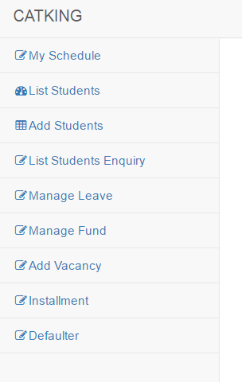
Branch Manager
Project description (contd.)
Branch manager functions are :-
List new students.
Monitor conversions
Apply for leaves
Request Funds
Add staff vacancy
Monitor defaulters and send alerts
Defaulters

Slide 19
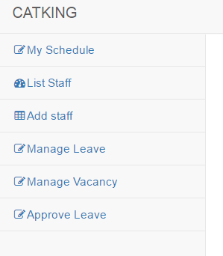
HR
Project description (contd.)
top functions are :-
Recruitment monitoring
Manage staff leaves
Manage vacancy
Make Schedule

Slide 20
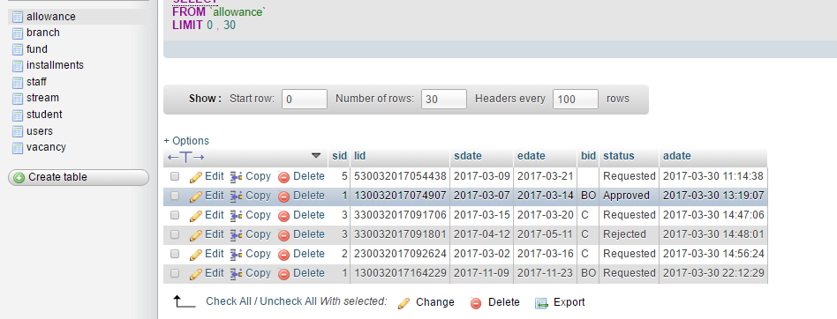
Project description (contd.)
Database Design

Slide 21
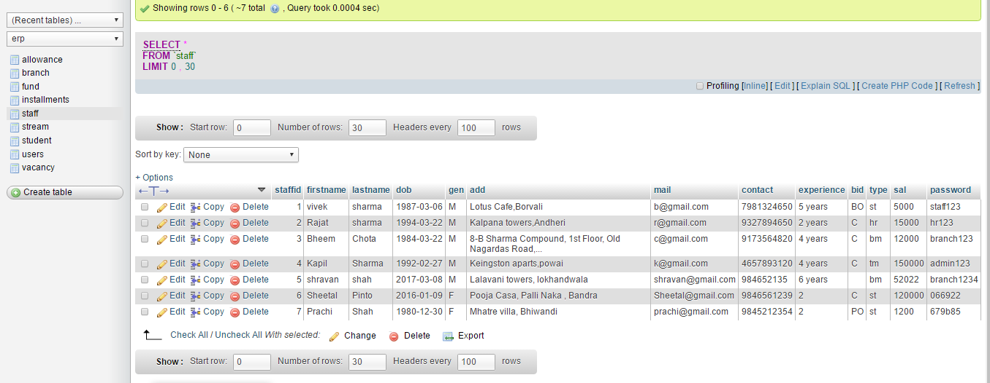
Project description (contd.)
Database Design – staff

Slide 22
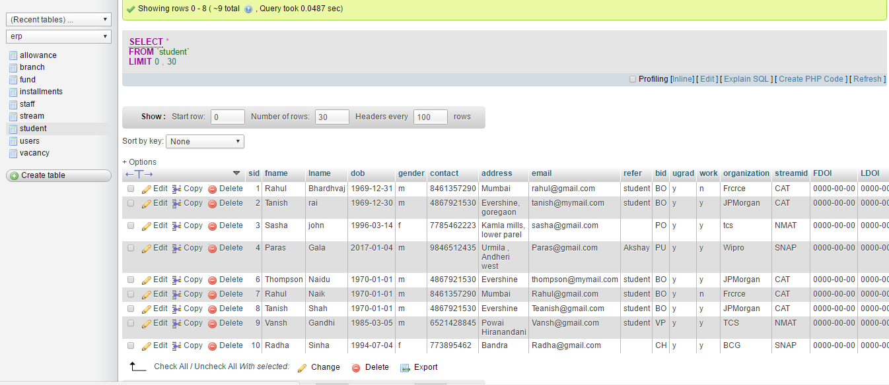
Project description (contd.)
Database Design – Student

Slide 23
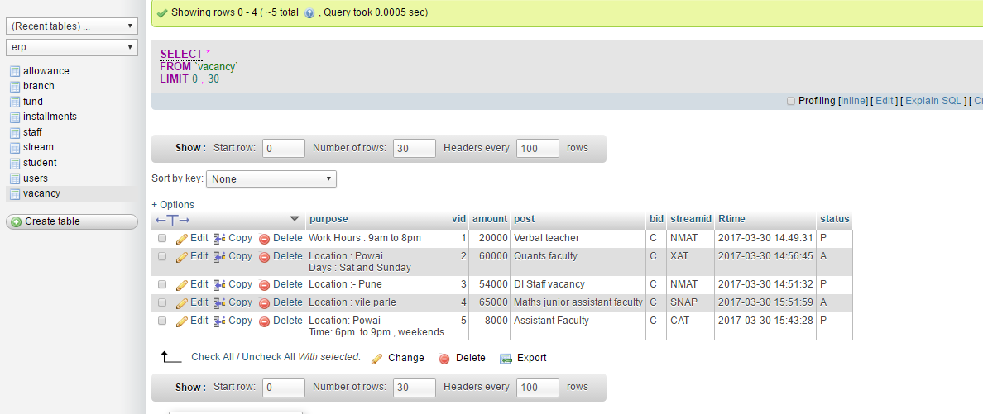
Project description (contd.)
Database Design – Vacancy

Slide 24
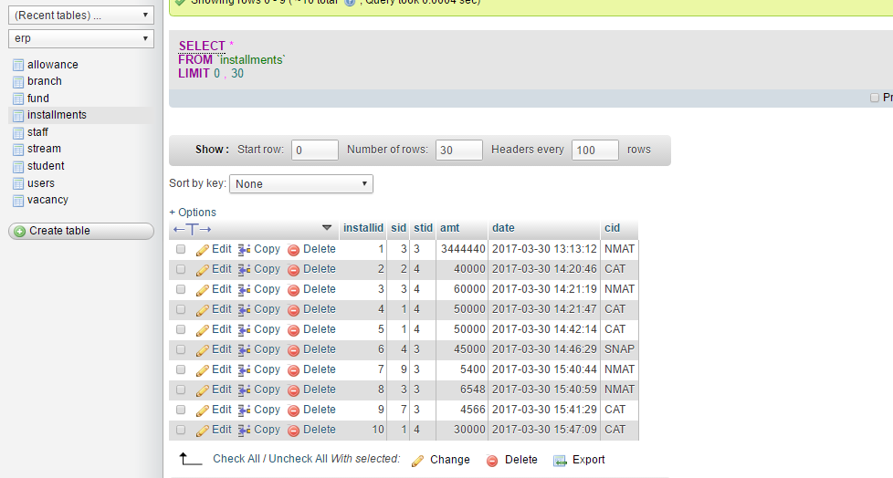
Project description (contd.)
Database Design – Installment

Slide 25
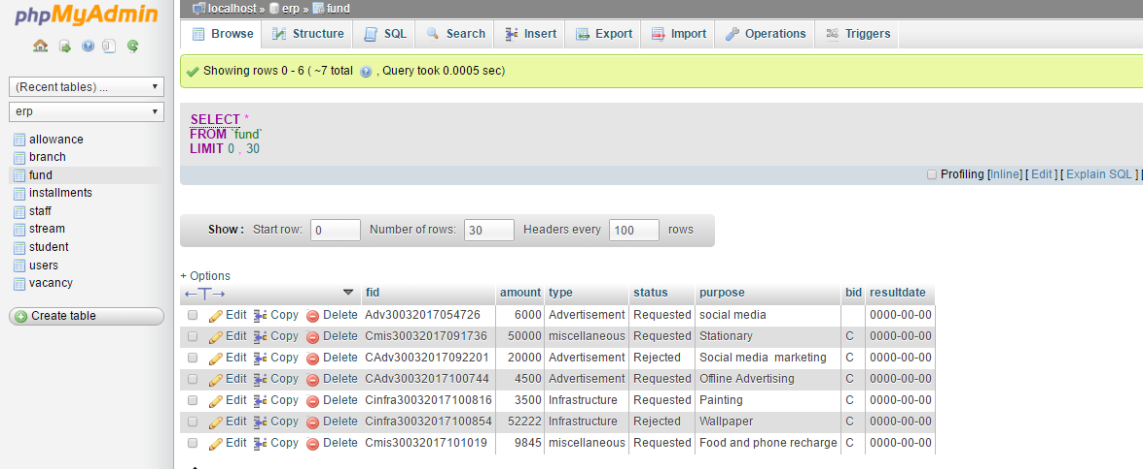
Project description (contd.)
Database Design- Funds

Slide 26
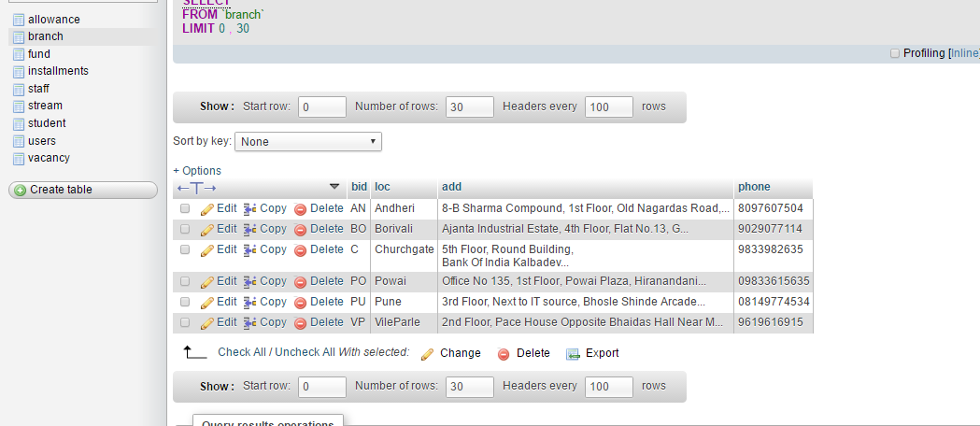
Project description (contd.)
Database Design- Branch

Slide 27
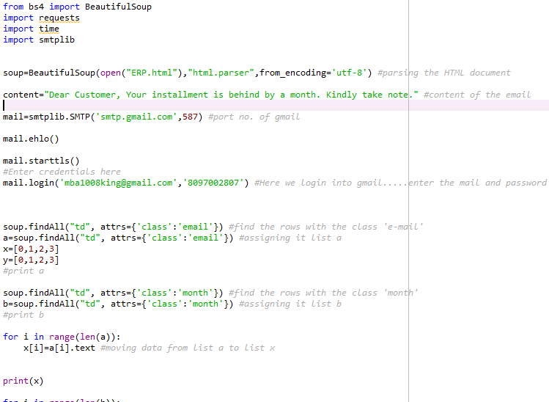
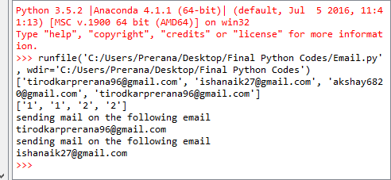
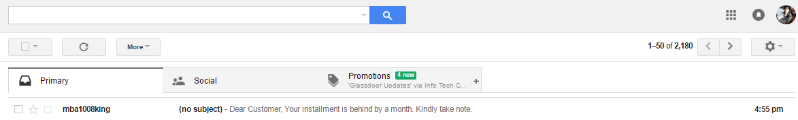
Email module
Project description (contd.)
Code
Output

Slide 28
Email module & SMS module
Project description (contd.)
3rd party integration
SMS :-MSG91
Email:- Gmail integration

Slide 29
Hardware and software requirements
Project description (contd.)
PIV Desktop/Laptop with minimum
160 GB HDD
2GB RAM
Hardware used
Software used
Operating system
Any OS
Application software
Xampp server/wamp , Anaconda, Jupiter server
PHP, MYSQL, Python

Slide 30
REFERENCES

Slide 31
References
Top 5 beneﬁts of implementing erp software,・http://www.workwisellc.com/
5-beneﬁts-implementing-erp-software/.
[2]摘rp advantages and disadvantages,・https://selecthub.com/
enterprise-resource-planning/erp-advantages-and-disadvantages/.
[3]鄭utoregressive integrated moving average,・https://en.wikipedia.org/wiki/
Autoregressive_integrated_moving_average.
[4]http://www.eresourceerp.com/Finance-Management.html.
[5]http://www.eresourceerp.com/Human-resource-management.html.
[6]http://www8.hp.com/in/en/software-solutions/system-performance-monitoring/.
[7]摘nterprise resource planning software buyer痴 guide,・http://technologyadvice.com/
erp/smart-advisor/.
[8]S. Rani, 鄭 review of erp implementation in higher education institutions,・International
Journal of Advanced Research in Computer Science and Software Engineering,
vol. 6, 2016.
[9]P. Soni, 摘rp implementation in organization,・http://www.slideshare.net/
PoojaSoni13/project-reporterpimplemetaion-24331857, 2013.

Slide 32
THANK YOU!

